Slide 1
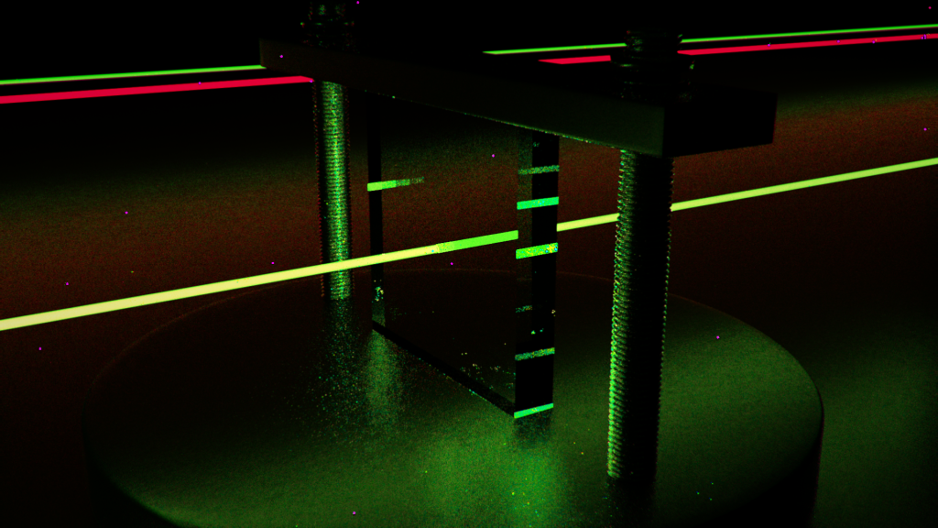
Vastestoffysica II
Saskia Blom
(s.blom@fontys.nl)

Slide 2
Inhoud college vandaag
Periodiek systeem
Röntgenstraling (§39.6 Brehmsstrahlung)
Fluorescentie, Fosforescentie
Kwantumstatistiek
Lasers

Slide 3
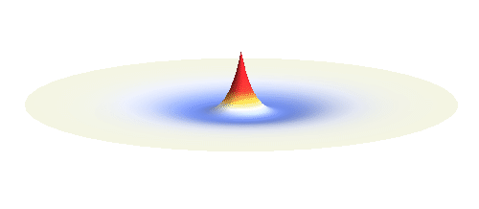
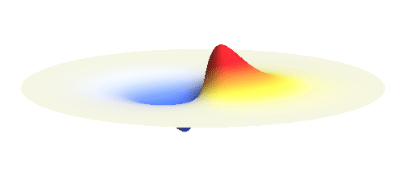
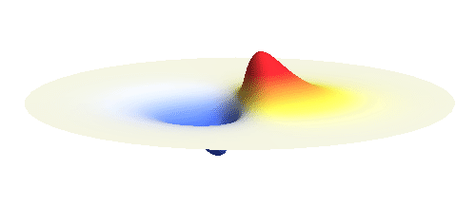
Waterstofatoom: golffunctie kansdichtheid
De kansdichtheidsverdelingen voor
n = 2 en = 0
n = 2 en = 1
2s
2 buiken in tegenfase
2p_{x}
Symmetrieën in de kansdichtheidsverdeling
➔ kwantumgetallen
Re (2p_{x} + i*2p_{y} )
https://tomasbzdusek.wordpress.com/
Notes:
a wave with angular momentum nħ transforms into “minus itself” after rotation by 360°/(2n).
https://tomasbzdusek.wordpress.com/

Slide 4
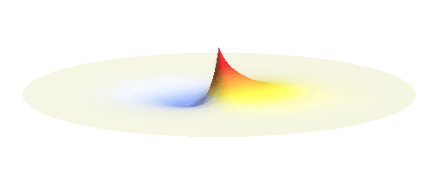
Waterstofatoom: golffunctie kansdichtheid
Algemener: de kansdichtheidsverdeling voor
n = 1 en = 0
n = 2 en = 1 (superpositie)
combinatie van de 1s en 2p_{x} subschil
3D: http://www.falstad.com/qmrotator/

Slide 5
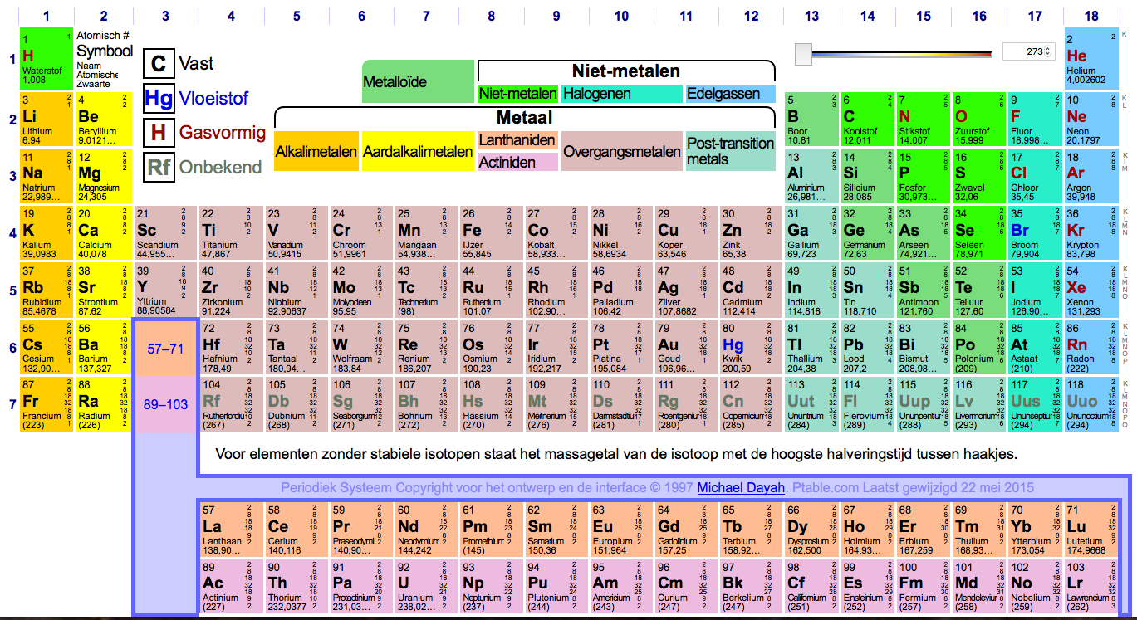
Periodiek systeem
Atoom#
Symbool
Naam
atoommassa
http://www.ptable.com/?lang=nl#Orbital
Notes:
¹⁹K: kalium: 4s¹
²⁰Ca: calcium: 4s²
²¹Sc: scandium: 4s² 3d¹
²²Ti: titaan: 4s² 3d²
²⁵Mn: mangaan: 4s² 3d⁵
²⁸Ni: nikkel: 4s² 3d⁸ / 4s¹ 3d⁹
²⁹Cu: koper: 4s¹ 3d¹⁰
³⁰Zn: zink: 4s² 3d¹⁰
³¹Ga: gallium: 4s² 3d¹⁰ 4p¹
³⁵Br: broom: 4s² 3d¹⁰ 4p⁵
³⁶Kr: krypton: 4s² 3d¹⁰ 4p⁶

Slide 6
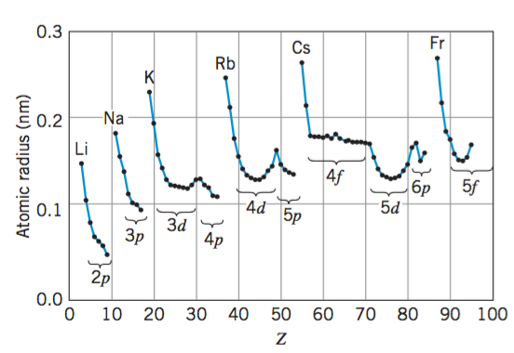
Atoomstraal
Gemeten via afstand in kristalrooster (→ geen H, He, Ne, Ar, Kr, Xe, Rn)
Hoofdgetal n is bepalend (in welke schil zit buitenste e⁻ ?)
Kleiner naarmate Z groter (alle e⁻ dichter bij de kern)
N-schil
(n=4)
M-schil
I
Br
Cl
L-schil
F
Notes:
¹⁹K: kalium: 4s¹
²⁰Ca: calcium: 4s²
²¹Sc: scandium: 4s² 3d¹
²²Ti: titaan: 4s² 3d²
²⁵Mn: mangaan: 4s² 3d⁵
²⁸Ni: nikkel: 4s² 3d⁸ / 4s¹ 3d⁹
²⁹Cu: koper: 4s¹ 3d¹⁰
³⁰Zn: zink: 4s² 3d¹⁰
³¹Ga: gallium: 4s² 3d¹⁰ 4p¹
³⁵Br: broom: 4s² 3d¹⁰ 4p⁵
³⁶Kr: krypton: 4s² 3d¹⁰ 4p⁶
Ch 8 Modern Physics by K. S. Krane
https://fisluisabraham.files.wordpress.com/2014/08/krane-k-modern-physics-3ed.pdf

Slide 7
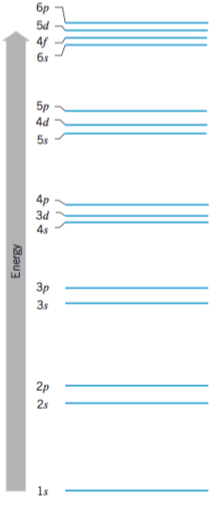
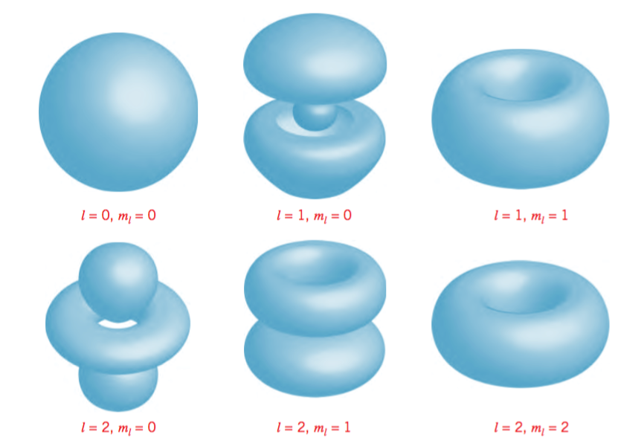
Volgorde vullen energieniveaus
Hoofdgetal n is niet altijd bepalend
d-subschil en f-subschil hogere energie dan volgende s-subschil
3s-subschil
3p-schil
3d-schil
Notes:
Ch 7, 8 Modern Physics by K. S. Krane
https://fisluisabraham.files.wordpress.com/2014/08/krane-k-modern-physics-3ed.pdf
Representations of |ψ|2 for different sets of quantum numbers. The z axis
is the vertical direction. The diagrams represent surfaces on which the probability has
the same value.
Atomic subshells, in order of increasing energy. The energy groupings are not to scale, but represent the relative energies of the subshells.
It is important to keep in mind exactly what is represented by this figure: the order of filling of the energy levels, and so representing only the “outer” or valence electrons. For example, the first 18 electrons fill the levels up through 3p, and the energy levels (subshells) available to the 19th electron in potassium (Z = 19) or calcium (Z = 20) are well described by this figure. However, the energy levels appropriate to the 19th electron in a heavy element such as lead (Z = 82) would be very different. In this case it is more correct to describe the atom in terms of shells—all of the n = 3 states (the M shell) are grouped together, as are all of the n = 4 states (the N shell), and so forth. When we discuss the inner structure of the atom, as in the case of X rays, the ordering of this figure is not appropriate, and it is more appropriate to group the levels by shells.

Slide 8
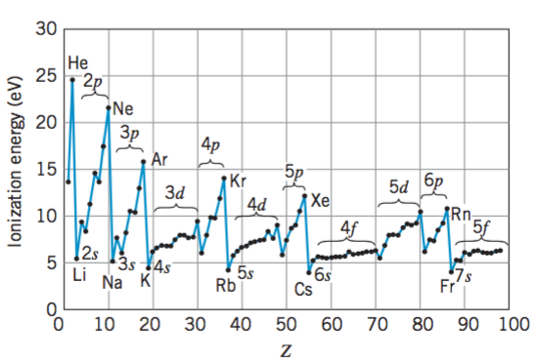
Ionisatie-energie
Maximaal voor edelgassen (volledig gevulde schil)
Hoger naarmate Z groter (alle e⁻ sterker aangetrokken tot de kern)
Lager voor s-subschil (e⁻ vaak ver van de kern, rest lading afgeschermd door overige e⁻)
Notes:
Ch 8 Modern Physics by K. S. Krane
https://fisluisabraham.files.wordpress.com/2014/08/krane-k-modern-physics-3ed.pdf

Slide 9
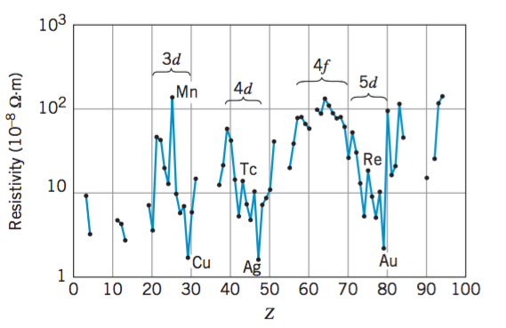
Soortelijke weerstand (elektrisch)
Gevulde d-subschil (zelfs halfgevuld) is stabieler dan gevulde s-schil; Bij Cu, Ag en Au gaat het e⁻ uit de s-schil naar de d-schil, overgebleven e⁻ in s-subschil is erg los gebonden (en locatie vaak ver van de kern)
Hg
Sc
Ga
U
Cs
Li
K
Cr
Na
Ca
Al
Notes:
²¹Sc: scandium: 4s² 3d¹
²⁴Cr chroom: 4s¹ 3d⁵
²⁵Mn mangaan: 4s² 3d⁵
⁸⁰Hg kwik: 6s² 5d¹⁰ 4f¹⁴ ⁽hydrargyros, uit Grieks hudor-, "water", en arguros, "zilver")
Ch 8 Modern Physics by K. S. Krane
https://fisluisabraham.files.wordpress.com/2014/08/krane-k-modern-physics-3ed.pdf
From the atomic point of view,
current depends on the movement of relatively loosely bound electrons, which
can be removed from their atoms by the applied potential difference, and also
on the ability of the electrons to travel from one atom to another. Thus
elements with s electrons, which are the least tightly bound and which also
travel farthest from the nucleus, are expected to have small resistivities.

Slide 10
Soortelijke weerstand (elektrisch)
Gevulde d-subschil (zelfs halfgevuld) is stabieler dan gevulde s-schil
3s-subschil
3p-schil
3d-schil
Notes:
Ch 7 Modern Physics by K. S. Krane
https://fisluisabraham.files.wordpress.com/2014/08/krane-k-modern-physics-3ed.pdf

Slide 11
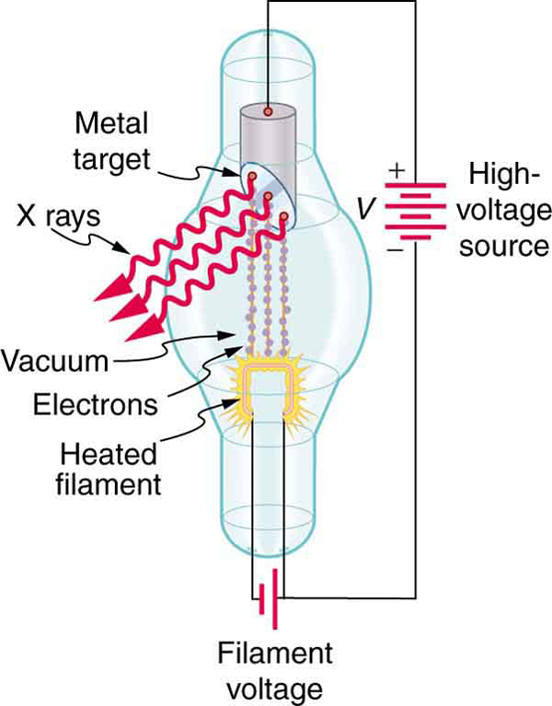
39.6 X-Ray Spectra and Atomic Number
The effective charge that an electron “sees” is the charge on the nucleus shielded by inner electrons. Only the electrons in the first level see the entire nuclear charge.
The energy of a level is proportional to Z ², so the wavelengths corresponding to transitions to the n = 1 state in high-Z atoms are in the X-ray range.
Bovenste energie-overgangen
(bij lagere energie te bereiken voor e-):
te lage energie voor X-ray
Wegschieten e- binnenste schillen,
dan grotere overgangen mogelijk
dus kortere golflengte
Notes:
http://cnx.org/content/m42563/latest/
http://smashingpicture.com/x-ray-photographer-nick-veasey/

Slide 12
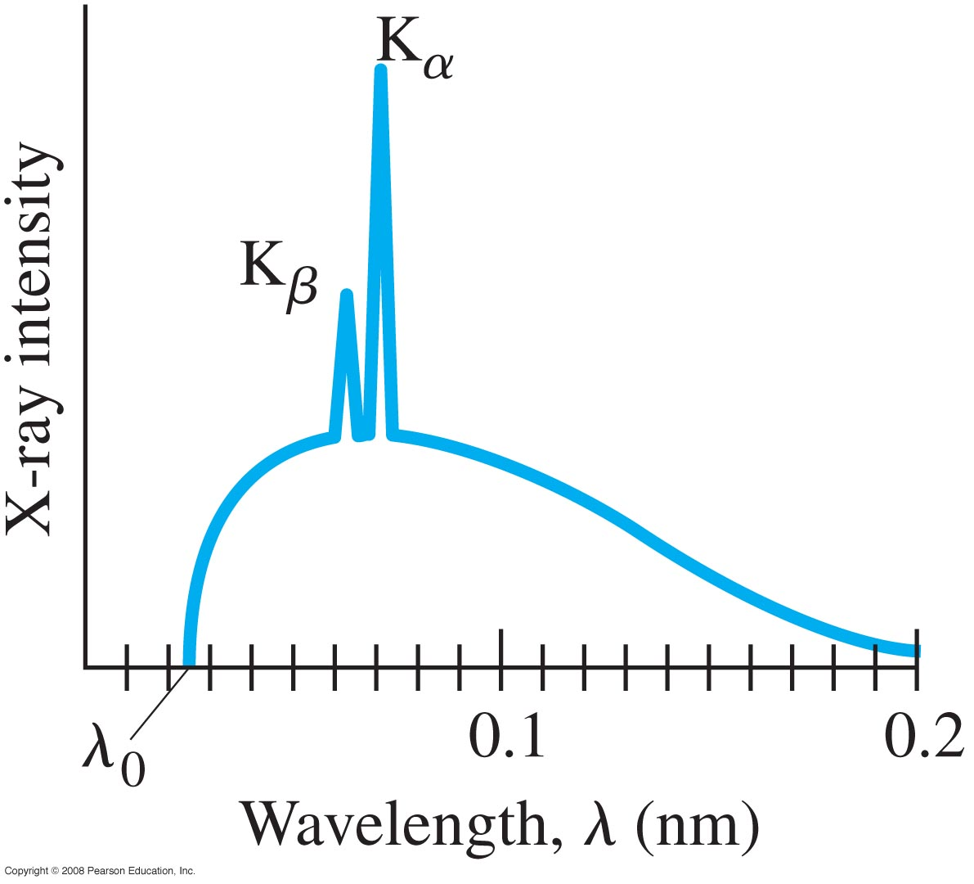
39.6 X-Ray Spectra and Atomic Number
Inner electrons can be ejected by high-energy electrons. The resulting X-ray spectrum is characteristic of the element.
This example is for molybdenum
Kans terugval van M naar K-schil
kleiner dan van L-schil
(e- dichterbij),
dus piek lager
Meer naar rechts:
L alfa, L beta, L_ gamma enz
→ terugvallen e- naar L-schil,
(vanuit M, N, O, enz - schillen)
e⁻ valt terug in K-schil;
K_{α} ➔ vanuit L-schil (n=2)
K_{β} ➔ vanuit M-schil (n=3)
Phet applet radiating charge:
http://phet.colorado.edu/en/simulation/radiating-charge
Notes:
Figure 39-11. Spectrum of X-rays emitted from a molybdenum target in an X-ray tube operated at 50 kV.
K alpha: n=2 (L) tp n=1
K beta: n=3 (M) tp n=1

Slide 13
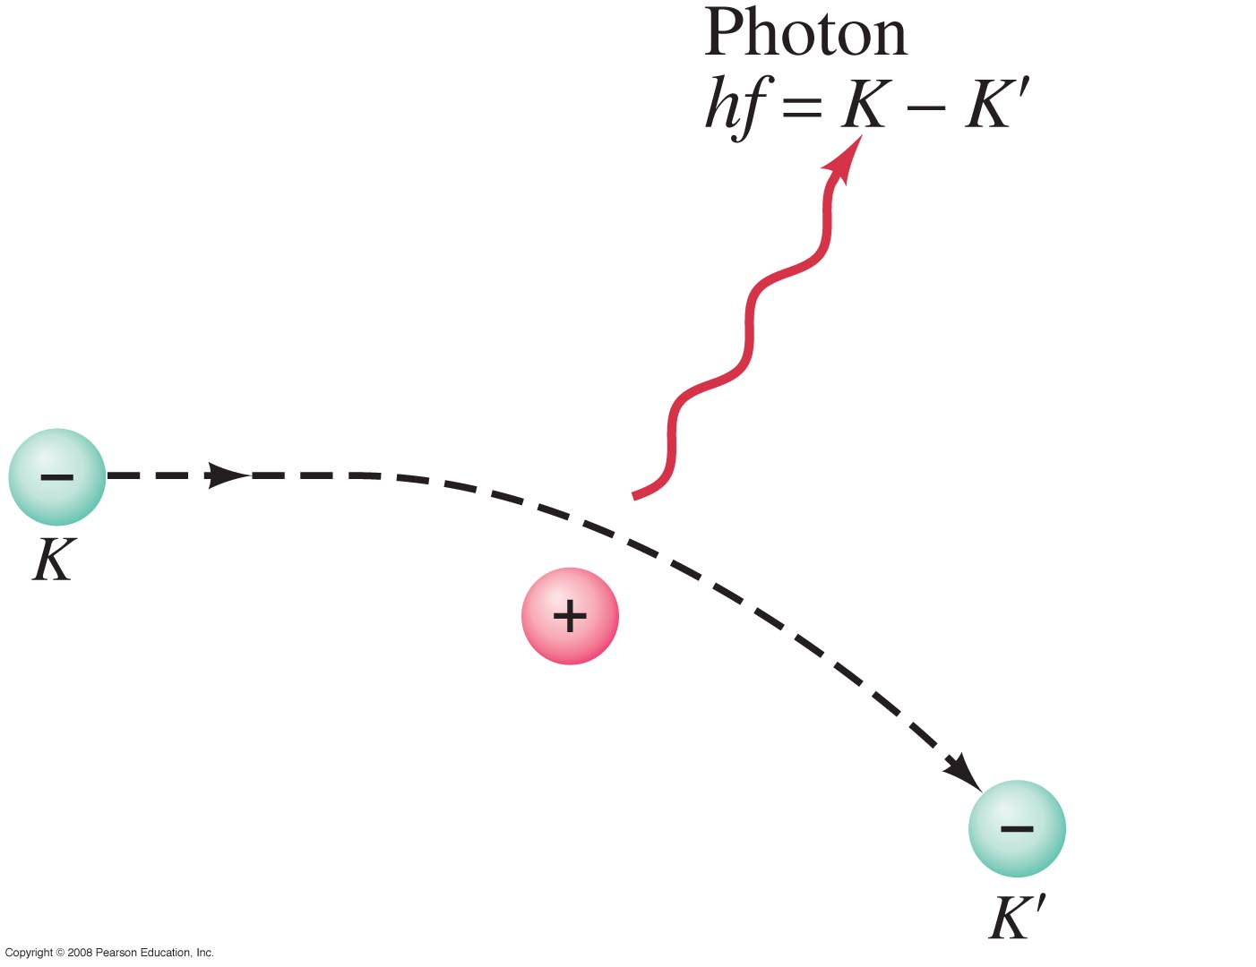
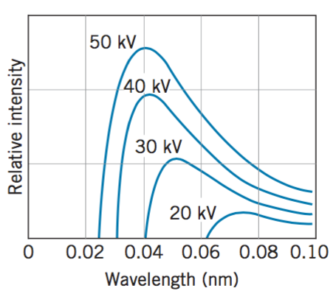
39.6 X-Ray Spectra and Atomic Number
The continuous part of the X-ray spectrum comes from electrons that are decelerated by interactions within the material, and therefore emit photons. This radiation is called bremsstrahlung (“braking radiation”).
Minimale golflengte bij
maximale kinetsiche
energie van e- → V max
Notes:
Figure 39-13. Bremsstrahlung photon produced by an electron decelerated by interaction with a target atom.
Ch 3.5 Modern Physics by K. S. Krane: some typical bremsstrahlung spectra. Each spectrum is labeled with the value of the accelerating voltage delta V.
https://fisluisabraham.files.wordpress.com/2014/08/krane-k-modern-physics-3ed.pdf

Slide 14
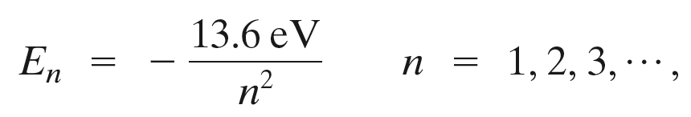
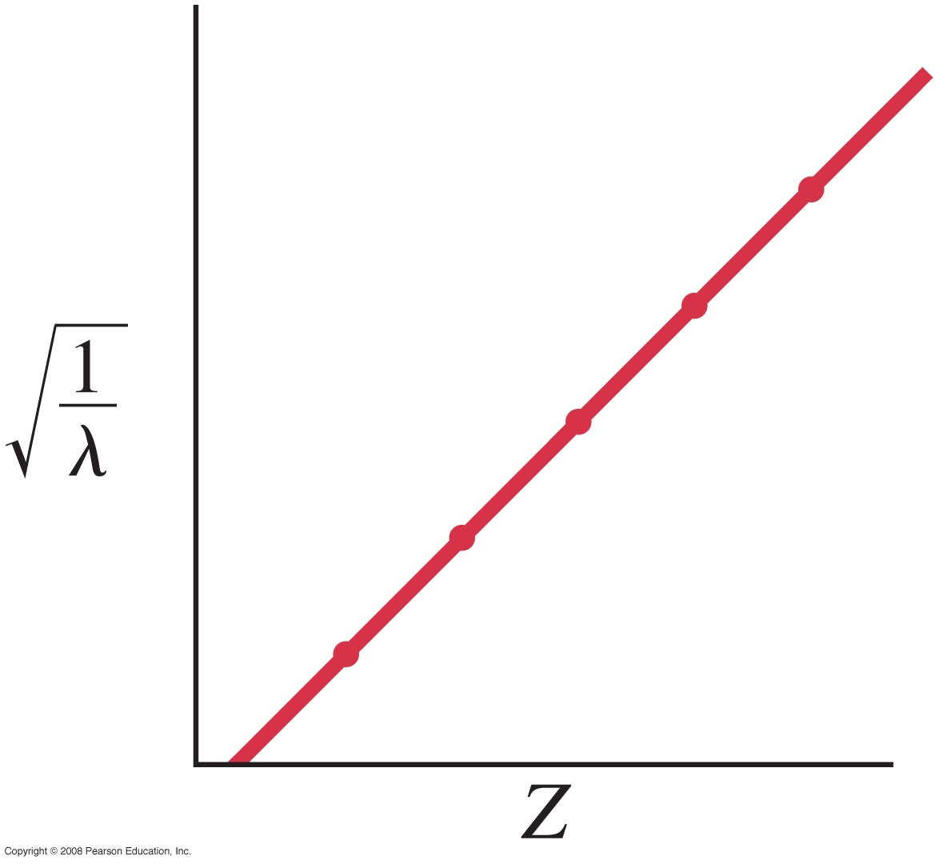
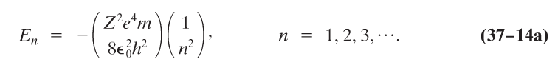
39.6 X-Ray Spectra and Atomic Number
Measurement of these spectra allows determination of inner energy levels, as well as Z, as the wavelength of the shortest X-rays is inversely proportional to Z².
Op één na geïoniseerd atoom: e⁻ heeft in K-schil energie E ~ Z²;
vanwege afscherming door 2e e⁻ energie E ~ (Z-1)²
(E ~ 1 / λ)
as-afsnijding: 1
Notes:
Figure 39-12. Plot of √(1/λ) vs. Z for K X-ray lines.
An electron in the L shell is normally screened by the two 1s electrons,
and so it sees an effective nuclear charge of Zeff = Z − 2. When one of those
1s electrons is removed in the creation of a K-shell vacancy, only the remaining
single 1s electron shields the L shell, and so Zeff = Z − 1. (In this calculation, we
neglect the small screening effect of the outer electrons; their probability densities
are not zero within the L-shell orbits, but they are sufficiently small that their
effect on Zeff can be neglected.)
To a very good approximation, the Kα X ray
can thus be analyzed as a transition from the n = 2 level to the n = 1 level in a
one-electron atom with Zeff = Z − 1.

Slide 15
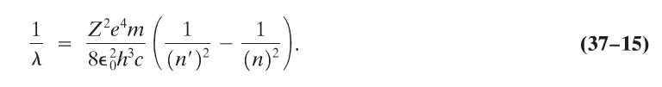
39.6 X-Ray Spectra and Atomic Number
Example 39-6: X-ray wavelength.
Estimate the wavelength for an n = 2 to n = 1 transition in molybdenum (Z = 42). What is the energy of such a photon?
Bohrmodel (37-14)
Z² vervangen door (Z-1)²
ΔE = 17 KeV
λ = 0.072 nm
Notes:
Solution: Using the Bohr formula (Equation 37-14) gives λ = 0.072 nm. The energy of this photon is hc/λ = 17 KeV (converting joules to eV).

Slide 16
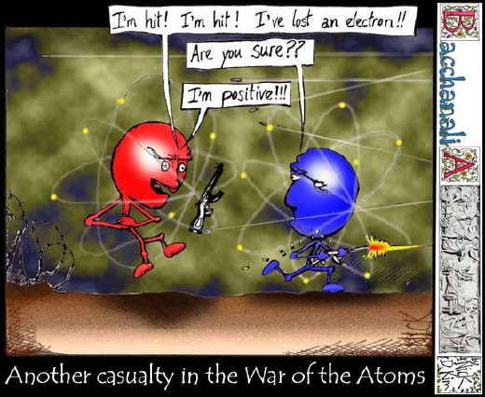
39.6 X-Ray Spectra and Atomic Number

Slide 17
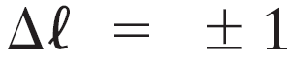
39.2 Hydrogen Atom: Schrödinger Equation and Quantum Numbers
“Allowed” transitions between energy levels occur between states whose value of differ by one:
Other, “forbidden,” transitions also occur but with much lower probability.
(due to conservation of angular momentum)
toegestaan: 3^{p} → 1^{s}
2^{p} → 1^{s}
maar: 3^{p} → 2^{p} verboden (Δ = 0)
3^{d} → 3^{s} verboden (Δ = 2)
Notes:
l=2-state → l =1 of l=3, niet l= 2 of l = 0
Photon carries angular momentum 1 * ħ (h-bar) → delta l = 1

Slide 18
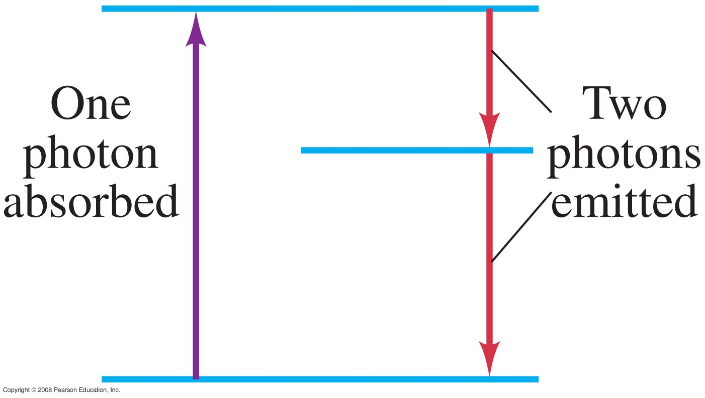
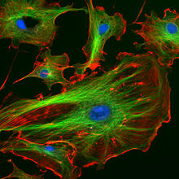
39.8 Fluorescence and Phosphorescence
If an electron is excited to a higher energy state, it may emit two or more photons of longer wavelength as it returns to the lower level.
Figure 39-15 goes here.
http://micro.magnet.fsu.edu/primer/java/jablonski/lightandcolor/
Notes:
Figure 39-15. Fluorescence.
In the special case of phosphorescence, the absorbed photon energy undergoes an unusual intersystem crossing into an energy state of higher spin multiplicity (see term symbol), usually a triplet state. As a result, the energy can become trapped in the triplet state with only classically "forbidden" transitions available to return to the lower energy state. These transitions, although "forbidden", will still occur in quantum mechanics but are kinetically unfavored and thus progress at significantly slower time scales. Most phosphorescent compounds are still relatively fast emitters, with triplet lifetimes on the order of milliseconds. However, some compounds have triplet lifetimes up to minutes or even hours, allowing these substances to effectively store light energy in the form of very slowly degrading excited electron states. If the phosphorescent quantum yield is high, these substances will release significant amounts of light over long time scales, creating so-called "glow-in-the-dark" materials.
where S is a singlet and T a triplet whose subscripts denote states (0 is the ground state, and 1 the excited state). Transitions can also occur to higher energy levels, but the first excited state is denoted for simplicity.
http://teaching.shu.ac.uk/hwb/chemistry/tutorials/molspec/lumin1.htm

Slide 19
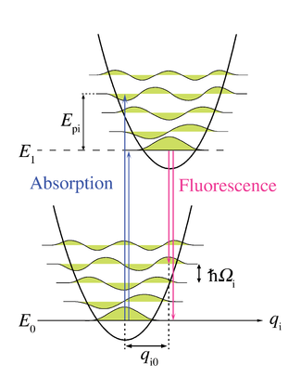
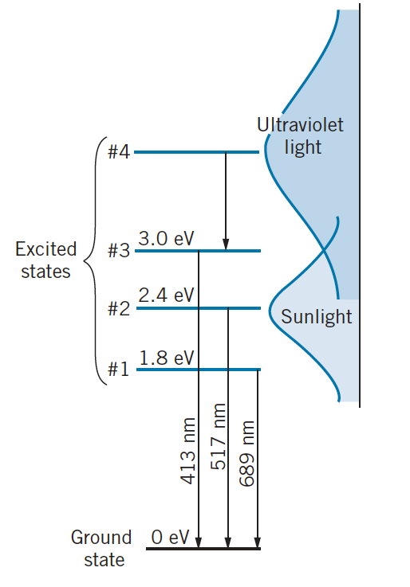
39.8 Fluorescence and Phosphorescence
Fluorescence occurs when the absorbed photon is ultraviolet and the emitted photons are in the visible range.
Phosphorescence occurs when the electron is excited to a metastable state; it can take seconds or longer to return to the lower state. Meanwhile, the material glows.
http://en.wikipedia.org/wiki/Zero-phonon_line_and_phonon_sideband

Slide 20
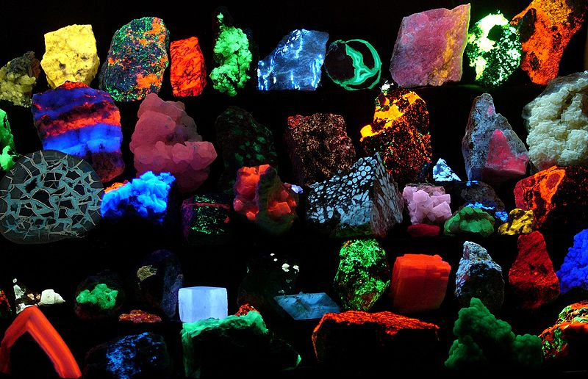
39.8 Fluorescence

Slide 21

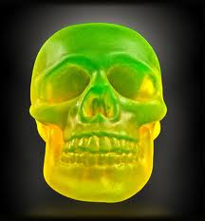
39.8 Phosphorescence

Slide 22

Herhaalde voorkennis
Golffunctie (beschrijft kans op meetresultaat)
Schrödingervergelijking
(on)eindig diepe potentiaalput
Tunneling
Heisenbergonzekerheid
Pauli-uitsluitingsprincipe
Energietoestanden atoom
Fluorescentie
Molecuulbinding
Moleculaire spectra
http://www.eng.fsu.edu/~dommelen/quantum/style_a/harm.html

Slide 23
Huiswerk
Doorlezen: Giancoli §39.1-6 & §39.8+9; & §40.1-5
Maak in Mastering Physics ‘week 2’
Maak Problems: 39_{3,15,36,40,54,55}
Huiswerkbespreking:
welkom mits voorbereid!

Slide 24
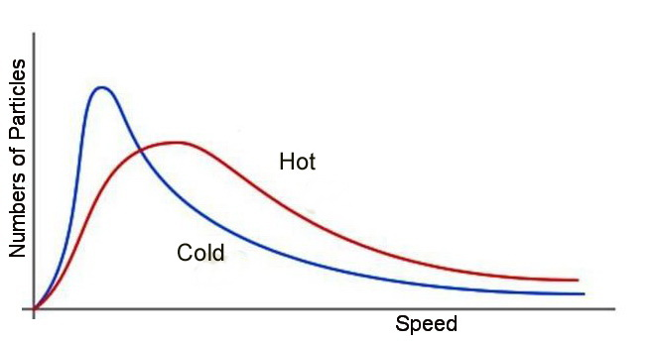
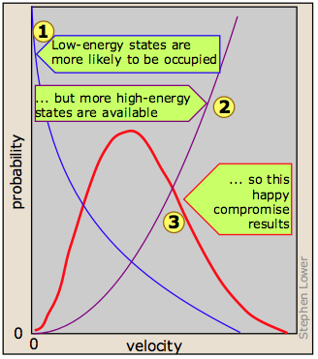
Klassieke statistiek
Maxwell-Boltzmannstatistiek:
meer manieren voor hoge energietoestand
combinaties van richtingen
waarom meer kans
op lage energietoestand?
totale hoeveelheid energie is beperkt
Gemiddelde bezetting van bepaald energieniveau
https://www.boundless.com/chemistry/gases/kinetic-molecular-theory/distribution-of-molecular-speeds-and-collision-frequency/
Notes:
To get a distribution function of the number of particles as a function of energy, the average population of each energy state must be taken. The average for each of the 9 states is shown below, and the plot of those averages as a function of energy.

Slide 25
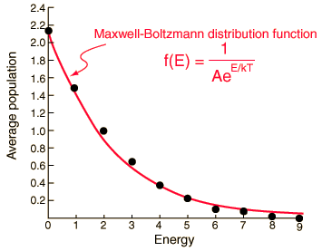
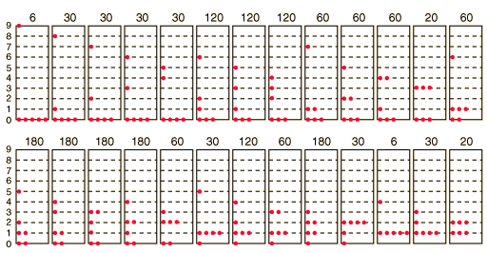
Gemiddelde bezetting van bepaald energieniveau
Maxwell-Boltzmannstatistiek:
26 manieren voor verdeling
van 9 eenheden energie
over 6 deeltjes
onderscheidbare deeltjes ➔
2002 manieren
http://hyperphysics.phy-astr.gsu.edu/hbase/quantum/disbol.html#c1
http://pcwww.liv.ac.uk/~awolski/Teaching/Liverpool/PHYS393/StatisticalPhysics-Part3-Handout.pdf
Notes:
To get a distribution function of the number of particles as a function of energy, the average population of each energy state must be taken. The average for each of the 9 states is shown below, and the plot of those averages as a function of energy.
http://hyperphysics.phy-astr.gsu.edu/hbase/quantum/disbol.html#c2
There are 26 possible macrostates for this system. The term "microstate" is used for the more detailed characterization in which the specific energy level for each particle is given. The macrostate at left has only 6 microstates, because there are only 6 ways to put one particle in level 9 and the other 5 in level 0. But there are 180 ways to achieve the macrostate at right, so if every distribution is presumed to be equally likely, then the system is 30 times more likely to be found in the right hand macrostate.
The number of distinguishable ways to produce each distribution is given by
So for the three macrostates pictured above, the numbers of microstates are
(Recall that 0!=1 so that the unoccupied states do not affect the calculation.)
Now to establish the distribution function for the number of particles in each energy state, the number of particles in each state must be averaged over all of the microstates. For each macrostate, the number of particles in a given energy level is multiplied by the number of microstates. The sum of those products is divided by the total number of microstates, which is 2002 in this case.
The number of microstates (the multiplicity W) for q units of energy among N equally probable states can be mathematically evaluated from the expression
which for this case becomes
Ch 10 p315-316 2nd ed Modern Physics by K. S. Krane: de constante A hangt af van de vorm van het infinitesimale volume-element in de faseruimte waarover je de kans bepaalt, en van de relatie tussen de toestandsvariablen. Hiervoor moet genormaliseerd worden.

Slide 26
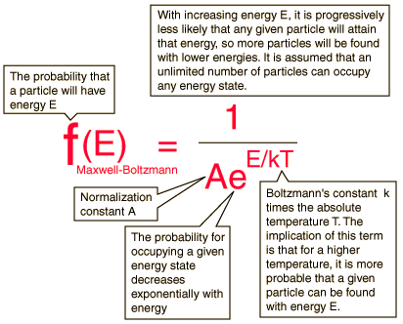
Statistiek bezetting beschreven door kansverdeling
Maxwell-Boltzmannstatistiek:
identieke, onderscheidbare deeltjes
http://hyperphysics.phy-astr.gsu.edu/hbase/quantum/disbol.html
http://www.gitam.edu/eresource/Engg_Phys/semester_2/mod_phys/dist_func.htm
http://pcwww.liv.ac.uk/~awolski/Teaching/Liverpool/PHYS393/StatisticalPhysics-Part3-Handout.pdf

Slide 27
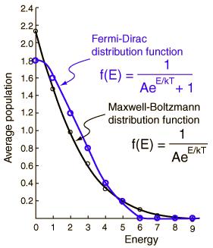
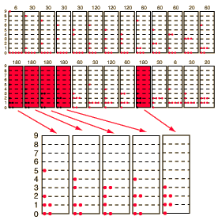
Kwantumstatistiek: bezetting door fermionen
Fermi-Dirac statistiek:
6 ononderscheidbare deeltjes ➔
slechts 5 manieren voor verdeling
van 9 eenheden energie
(Pauli) voor spin ½:
maximaal twee e⁻
per energieniveau
⬆⬇
➔ andere verdelingen uitgesloten!
1/5
2/5
4/5
6/5
8/5
9/5
Notes:
Spin is intrinsiek (een relativistische noodzaak)
P. A. M. Dirac showed in 1928 that relativistic quantum theory for the electron gives the electron spin directly as an additional quantum number.
Zie p. 215
Ch 7.6 Modern Physics by K. S. Krane

Slide 28
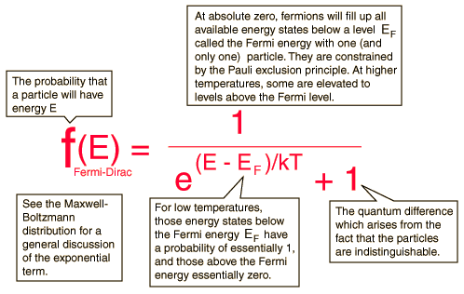
Kwantumstatistiek: bezetting door fermionen
Fermi-Dirac statistiek:
identieke, ononderscheidbare deeltjes
met spin ½
(Fermionen: protonen, neutronen, e⁻)
http://pcwww.liv.ac.uk/~awolski/Teaching/Liverpool/PHYS393/StatisticalPhysics-Part4-Handout.pdf
http://hyperphysics.phy-astr.gsu.edu/hbase/quantum/disfdx.html#c2
Notes:
Fermi-Dirac statistics differ dramatically from the classical Maxwell-Boltzmann statistics in that fermions must obey the Pauli exclusion principle. Considering the particles in this example to be electrons, a maximum of two particles can occupy each spatial state since there are two spin states each. Whereas there were 26 possible configurations for distinguishable particles, these are reduced to the 5 states which have no more than two particles in each state.Evaluating the average occupancy of each energy state is much simpler than in the Maxwell-Boltzmann example since each macrostate has a weight of 1. The average occupancy is just the sum of the numbers of particles in a given energy state over all the 5 distributions divided by 5.

Slide 29
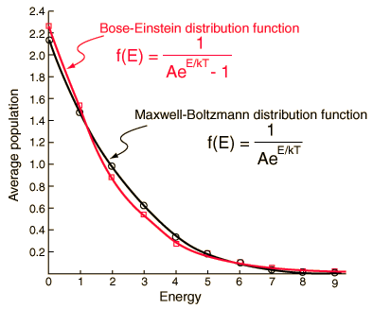
Kwantumstatistiek: bezetting door bosonen
Bose-Einstein statistiek:
6 ononderscheidbare deeltjes ➔
26 manieren voor verdeling
van 9 eenheden energie
identieke, ononderscheidbare deeltjes
met spin 1
(Bosonen: fotonen, fononen, Higgs)
http://hyperphysics.phy-astr.gsu.edu/hbase/quantum/disbex.html#c2
http://pcwww.liv.ac.uk/~awolski/Teaching/Liverpool/PHYS393/StatisticalPhysics-Part5-Handout.pdf
Notes:
Low energy states are more probable with Bose-Einstein statistics than with the Maxwell-Boltzmann statistics. While that excess is not dramatic in this example for a small number of particles, it becomes very dramatic with large numbers and low temperatures. At very low temperatures, bosons can "condense" into the lowest energy state. The phenomenon called Bose-Einstein condensation is observed with liquid helium and is responsible for its remarkable behavior.

Slide 30
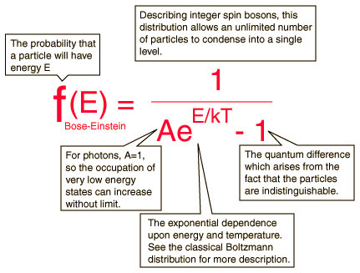
Kwantumstatistiek: bezetting door bosonen
Bose-Einstein statistiek:
6 ononderscheidbare deeltjes ➔
26 manieren voor verdeling
van 9 eenheden energie
identieke, ononderscheidbare deeltjes
met spin 1
(Bosonen: fotonen, fononen, Higgs)
http://hyperphysics.phy-astr.gsu.edu/hbase/quantum/disbex.html#c2
https://www.st-andrews.ac.uk/physics/quvis/simulations_html5/sims/FermionsBosons/FermionsBosons.html
Notes:
Low energy states are more probable with Bose-Einstein statistics than with the Maxwell-Boltzmann statistics. While that excess is not dramatic in this example for a small number of particles, it becomes very dramatic with large numbers and low temperatures. At very low temperatures, bosons can "condense" into the lowest energy state. The phenomenon called Bose-Einstein condensation is observed with liquid helium and is responsible for its remarkable behavior.

Slide 31
Overzicht statistiek verdeling van energie over deeltjes
Maxwell-Boltzmannstatistiek:
Fermi-Diracstatistiek:
Bose-Einsteinstatistiek:
identieke, onderscheidbare deeltjes
identieke, ononderscheidbare deeltjes
met spin ½ [max. 2 per hokje]
(Fermionen: protonen, neutronen, e⁻)
identieke, ononderscheidbare deeltjes
met spin 1
(Bosonen: fotonen, fononen, Higgs)
http://hyperphysics.phy-astr.gsu.edu/hbase/quantum/disbex.html#c2
Notes:
Low energy states are more probable with Bose-Einstein statistics than with the Maxwell-Boltzmann statistics. While that excess is not dramatic in this example for a small number of particles, it becomes very dramatic with large numbers and low temperatures. At very low temperatures, bosons can "condense" into the lowest energy state. The phenomenon called Bose-Einstein condensation is observed with liquid helium and is responsible for its remarkable behavior.

Slide 32
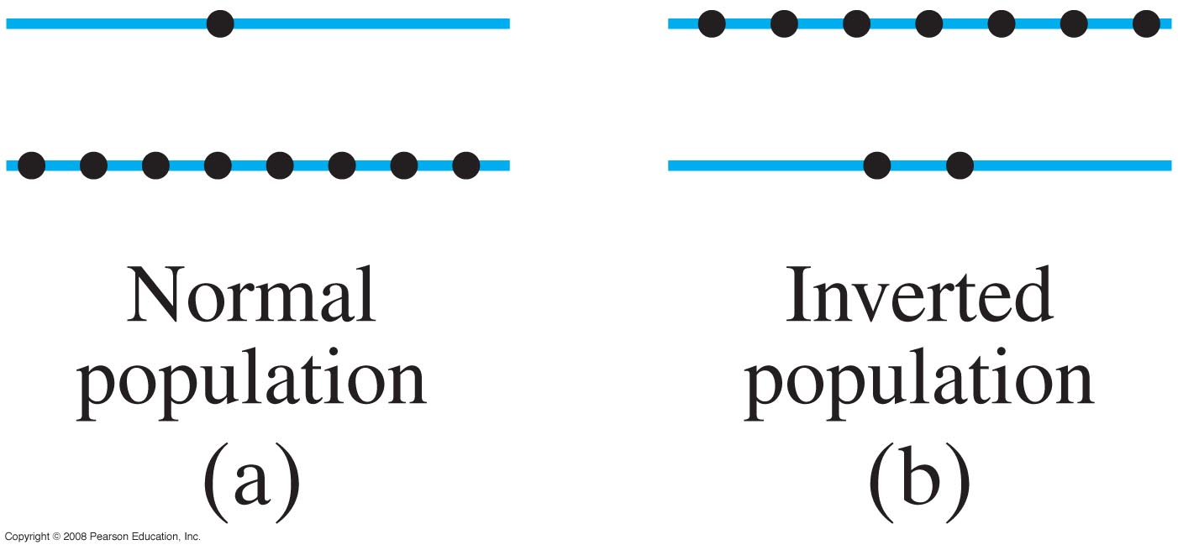
Bereken kans dat e⁻ in aangeslagen toestand zit
Bij kamertemperatuur geldt: kT ~ 0,025 eV Stel: = E₂ – E₁ = 2 eV
Welk deel van de e⁻ zit in E₂ ?
uitgezonden foton bij terugvallen
is zichtbaar licht
Boltzmanndistributie:
verdeling energieniveaus:
E₂
E₁
N₂ /N₁ = e ^{–( E}₂ ^{– E}₁⁾
= e ^{–80} = 2 10⁻³⁵
http://en.wikipedia.org/wiki/Active_gain_medium
Notes:
Zichtbaar licht 1,5 eV tot 3,1 eV, zeg 2 eV
Kamertemperatuur: 1/40 = 0,025 eV
e-macht: e^-80 = 2 10^-35!!!
Figure 39-18. Two energy levels for a collection of atoms. Each dot represents the energy state of one atom. (a) A normal situation; (b) an inverted population.
Dus in evenwicht (Boltzmann) heb je altijd veel meer e- in toestand met lagere energie (n>m ➔ N_n << N_m)
A population cannot be achieved in a group of atoms with two energy-levels when they are in thermal equilibrium. In fact, any method by which the atoms are directly and continuously excited from the ground state to the excited state (such as optical absorption) will eventually reach equilibrium with the de-exciting processes of spontaneous and stimulated emission. At best, an equal population of the two states, N₁ = N₂ = N/2, can be achieved, resulting in optical transparency but no net optical gain.

Slide 33
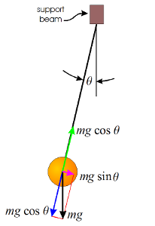
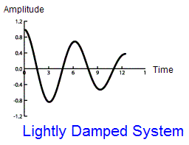
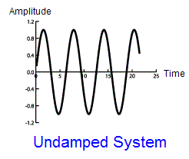
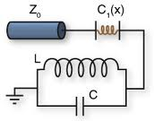
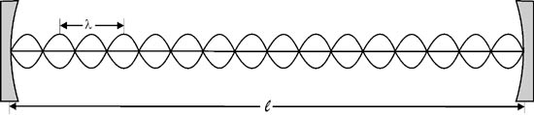
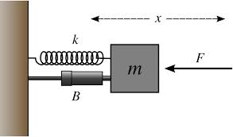
§39.9 Lasers
Laser: light amplification by stimulated emission of radiation
optische oscillator (optische versterking!)
http://www.ryerson.ca/~kantorek/ELE884/Lasers.htm

Slide 34

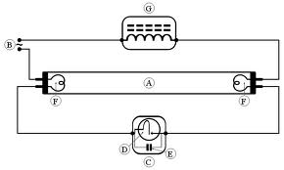
§39.9 Lasers: versterken
Laser: light amplification by stimulated emission of radiation
optische oscillator (optische versterking!)
TL: versterking
elektrische stroom
door hoogspanning

Slide 35
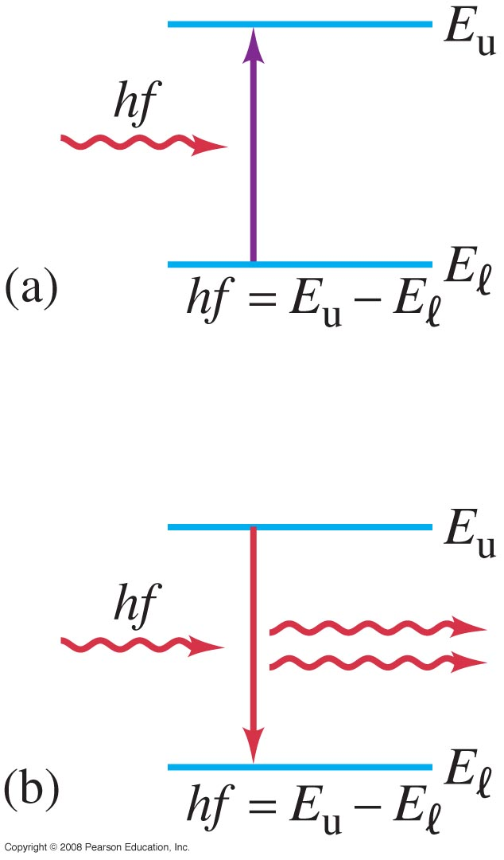
39.9 Lasers
A laser produces a narrow, intense beam of coherent light. This coherence means that, at a given cross section, all parts of the beam have the same phase.
(a): absorption of a photon.
After a while, excited atom falls back: spontaneous emission
(b) stimulated emission if atom is in excited state, another photon of same frequency can stimulate the atom to fall back sooner. The photons are in phase.
Notes:
Valt spontaan terug in 10^-8 seconde
Figure 39-17. (a) Absorption of a photon. (b) Stimulated emission. E_{u} and E_{l} refer to “upper” and “lower” energy states.

Slide 36
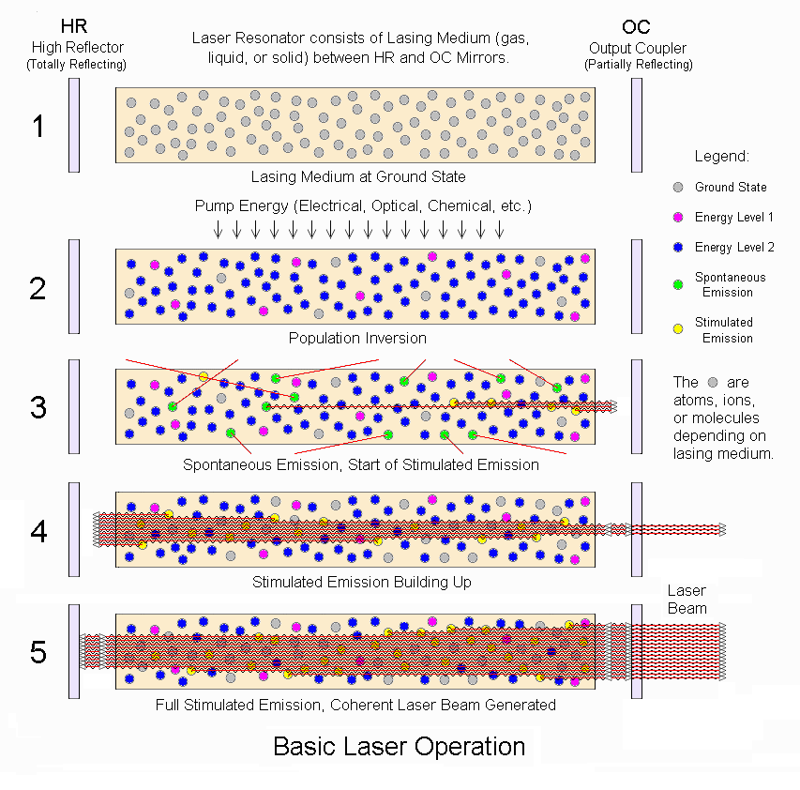
Notes:
http://oregonstate.edu/ehs/book/export/html/383
Chemical oxygen iodine laser

Slide 37
§39.9 Laserwerking
Om via gestimuleerde emissie coherent licht te krijgen, twee voorwaarden:
meerderheid in aangeslagen toestand: ‘geinverteerde populatie’.
pompen naar hogere toestand
(energie opslaan)
Boltzmanndistributie:
verdeling energieniveaus:
twee normale niveaus: geen populatie-inversie mogelijk!
http://en.wikipedia.org/wiki/Active_gain_medium
Notes:
Zichtbaar licht 1,5 eV tot 3,1 eV, zeg 2 eV
Kamertemperatuur: 1/40 = 0,025 eV
e-macht: e^-80 = 2 10^-35!!!
Figure 39-18. Two energy levels for a collection of atoms. Each dot represents the energy state of one atom. (a) A normal situation; (b) an inverted population.
Dus in evenwicht (Boltzmann) heb je altijd veel meer e- in toestand met lagere energie (n>m ➔ N_n << N_m)
A population cannot be achieved in a group of atoms with two energy-levels when they are in thermal equilibrium. In fact, any method by which the atoms are directly and continuously excited from the ground state to the excited state (such as optical absorption) will eventually reach equilibrium with the de-exciting processes of spontaneous and stimulated emission. At best, an equal population of the two states, N₁ = N₂ = N/2, can be achieved, resulting in optical transparency but no net optical gain.

Slide 38
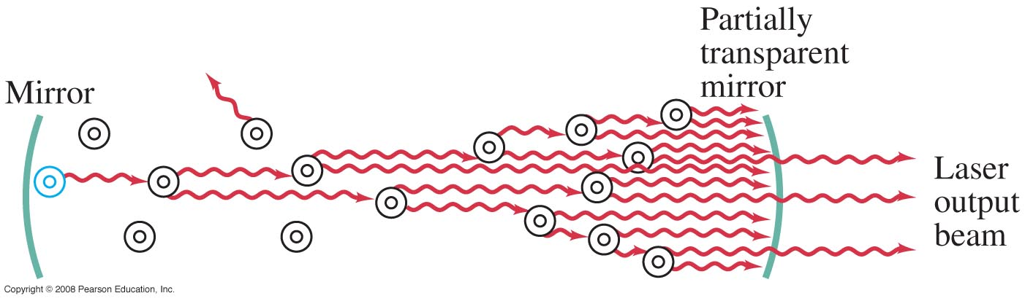
§39.9 Laserwerking
Om via gestimuleerde emissie coherent licht te krijgen, twee voorwaarden:
2. metastabiele toestand
(spontane emissie voorkomen;
spiegels: richting van het licht & meer kans op gestimuleerde emissie)
2. The higher state must be a metastable state, so that once the population is inverted, it stays that way. This means that transitions occur through stimulated emission rather than spontaneously.
Notes:
Figure 39-19. Laser diagram, showing excited atoms stimulated to emit light.

Slide 39
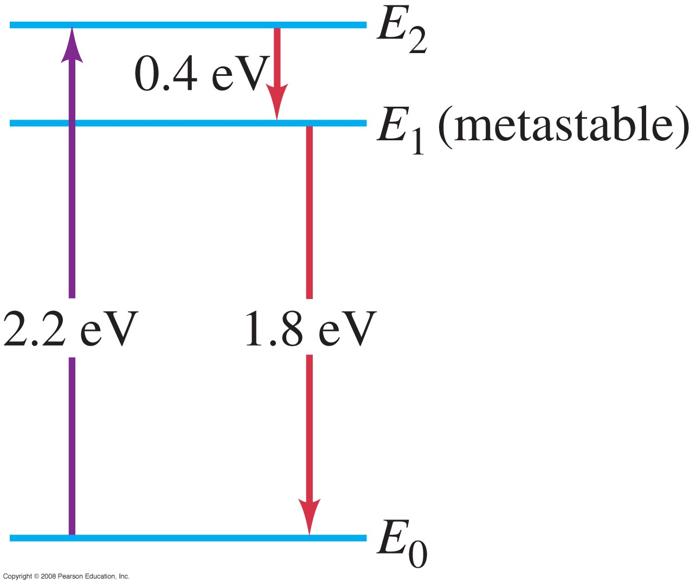


39.9 Lasers
The laser beam is narrow, only spreading due to diffraction, which is determined by the size of the end mirror.
An inverted population can be created by exciting electrons to a state from which they decay to a metastable state. This is called optical pumping.
Energy levels of chromium in a ruby crystal
Notes:
Figure 39-20. Energy levels of chromium in a ruby crystal. Photons of energy 2.2 eV “pump” atoms from E₀ to E₂ which then decay to metastable state E₁. Lasing action occurs by stimulated emission of photons in transition from E₁ to E₀.
Al2O3 sommige Al vervangen door chroom
flitsen met 550 nm of wit licht van Xenonlamp
In a three-level system, the laser transition ends on the ground state. The unpumped gain medium exhibits strong absorption on the laser transition. A population inversion and consequently net laser gain result only when more than half of the ions (or atoms) are pumped into the upper laser level; the threshold pump power is thus fairly high. http://www.rp-photonics.com/four_level_and_three_level_gain_media.html
The ruby laser is a three level solid state laser. The active laser medium (laser gain/amplification medium) is a synthetic ruby rod that is energized through optical pumping, typically by a xenon flashtube. Ruby has very broad and powerful absorption bands in the visual spectrum, at 400 and 550 nm, and a very long fluorescence lifetime of 3 milliseconds. This allows for very high energy pumping, since the pulse duration can be much longer than with other materials. While ruby has a very wide absorption profile, its conversion efficiency is much lower than other mediums.[3]

Slide 40
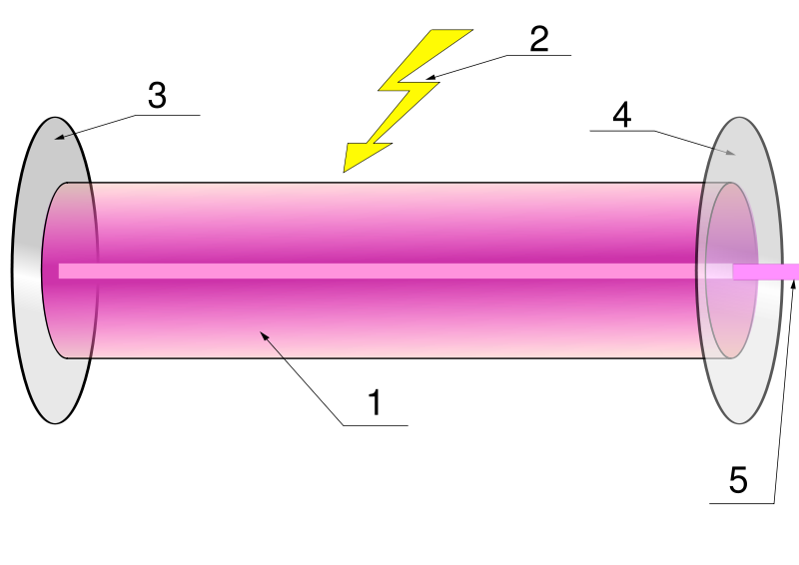
§39.9 Lasers:
optische oscillator: twee spiegels vormen trillingsholte (Fabry-Perot cavity)
versterking: pompen: energiebron (optisch, elektrisch, …)
➔ energieopslag in metastabiele toestand (verlaagde spontane emissie)
➔ dit zorgt voor populatie-inversie in het gain medium
➔ nu is gestimuleerde emissie mogelijk
Bij deze criteria zal een foton // hoofdas v.d. spiegels versterkt worden
→ coherente vlakke golf: laserbundel
Notes:
Lasermedium: http://www.enlightenyourmind.net/Graphics/laser2.jpggain medium, optical gain medium, active gain medium, active laser medium,
Active laser medium 2. Laser pumping energy 3. High reflector 4. Output coupler (partially reflecting) 5. coherent, intense plane wave
1 pompen + populatie inversie (energie toevoegen),
2 spiegels + metastabiele toestand (energie opslaan)
3 gestimuleerde emissie + gedeeltelijk doorlatende spiegel (vrijmaken energie via sneeuwbaleffect dat coherent licht oplevert)

Slide 41

§39.9 Lasers:
A metastable state can also be created through interactions between two sets of atoms, such as in a helium—neon laser.
E_{3,Ne} = E_{1,He} + 0,05 eV
metastabiele
toestand
elektrisch
pompen
metastabiel, → niet met één foton aan te slaan
waarom niet met licht pompen?
http://www.lexellaser.com/techinfo_wavelengths.htm
Notes:
Figure 39-21. Energy levels for He and Ne. He is excited in the electric discharge to the E₁ state. This energy is transferred to the E₃’ level of the Ne by collision. E₃’ is metastable and decays to E₂’ by stimulated emission.

Slide 42



39.9 Laser transitions
3-level
4-level
medium in
grondtoestand
doorzichtig
medium in
grondtoestand
ondoorzichtig
l=6
pulsed
l=3
als lower laser level (LLL)
heeft lange levensduur →
grondtoestand ‘leeg’
pulsduur: 20 ns (levensduur ULL)
duur tussen pulsen 40 μs
(levensduur LLL)
Nd:YAG
N₂ -laser
http://www.rp-photonics.com/laser_transitions.html
http://technology.niagarac.on.ca/people/mcsele/lasers/Quantum.htm
http://www.rp-photonics.com/ytterbium_doped_gain_media.html
Notes:
^{2S+1}L_{J} the crystal splits these into J + ½ sublevels.
A carbon-dioxide laser's output is brought about by rotational energy levels and occurs in the far infrared at 10.6 microns
http://technology.niagarac.on.ca/people/mcsele/lasers/Quantum.htm
Yb3+: http://www.rp-photonics.com/ytterbium_doped_gain_media.html
In a nitrogen laser, for example, the lasing transition is a vibronic one involving both electronic and vibrational levels. This leads to a gas laser transition with relatively broadband output (0.1nm) - many times wider than 'traditional' gas lasers. The energy levels defining this gas laser are really 'bands' where transitions can occur between these bands giving a range of possible wavelengths rather than a sharply defined line.
Erbium niet efficiënt maar nuttig voor glasfibers; Erbium-doped optical fibre amplifiers
Dye lasers usually involve all three mechanisms which leads to a continuum output over a given range. By tuning the feedback mechanism one can selectively amplify a given wavelength - these lasers are truly tunable.
Remember, too, that quantum mechanics can give rise to amazingly large numbers of closely-spaced levels. This happens in ion lasers (see below) where there are a number of laser transitions closely spaced (in the case of an argon ion laser, ten lasing lines appear in the blue-green-violet region).
Nd:YAG is een acroniem voor "neodymium-gedoteerd YAG-kristal" (Nd:Y3Al5O12), waarbij YAG staat voor yttrium-aluminium-granaat
To complicate matters there are also four-level lasers like the YAG. In the YAG laser energy absorbed by the laser rod pumps an upper energy level (actually two levels but who's counting :) which decays quickly (without radiating energy) to an upper laser level. From there neodymium atoms emit a photon at 1064nm (IR) and fall in energy to a lower laser state. Finally atoms at the lower state fall to ground state and the cycle begins again. Incidentally, the lasing transition in the YAG laser is from an 'F' level to an 'I' level (n=6 to n=3). Four levels are involved here: the upper pumped level, two lasing levels, and the ground level. Four level lasers are notoriously efficient. Main laser transition at 1064 nm
Level Lifetime
One problem that might be encountered along the way is the lifetime of lasing levels. Some levels have very long lifetimes (metastable). If the lower level of the lasing transition has a longer lifetime than the upper level then lasing action may not be possible at all or might be possible only in pulsed mode. Many practical lasers such as the nitrogen and copper-vapour laser have this situation. In both these cases, the upper-lasing levels can be preferentially filled, quickly, by a pulsed discharge of 100's of amperes or more! If the upper level fills quickly and population inversion can be achieved, lasing action will begin. Soon, though, the lower lasing level fills, the population at that level exceeding the upper level (and staying that way since it's lifetime is longer) and lasing ceases. In the case of the , lasing ceases after 10-20nS. In the copper-vapour laser, about 150nS. Both of these lasers operate strictly in pulsed mode and CW laser action cannot be achieved. %
N2-laser The metastable lower level lifetime is 40 μs (25 kHz), thus, the laser self-terminates, typically in less than 20 ns.
http://en.wikipedia.org/wiki/Nitrogen_laser
Vulgas: a mix of a noble gas (up to 0.9) and nitrogen enhance elastic scattering of electrons over electron multiplying and thus widens avalanches and streamers.
Ga naar: navigatie, zoeken
Q-switch is een Engelse term (Duits: Güteschalter) om een toestel aan te duiden dat van een continue (CW, Engels: Continuous Wave, Duits: Dauerstrich) laser (licht) korte, grote pulsen maakt (Duits: Riesenimpuls) door de kwaliteitsfactor (Engels: Quality factor) Q van laag naar hoog te schakelen. Doorgaans is het toestel een akoesto-optische modulator. Die bevindt zich in de laserresonator, dus binnen de spiegels. Als de modulator in de ene stand staat, is de kwaliteitsfactor Q van de resonator laag en gaat al het pompvermogen in de maximale populatie-inversie. Als dan de modulator naar de andere stand gaat, verhoogt Q naar de normale waarde en komt al de opgeslagen energie vrij in een korte puls (rond 100 nanoseconde). De modulator schakelt typisch aan een frequentie tussen 1 en 10 kHz. De Q-switch wordt veel gebruikt met een Nd:YAG laser.

Slide 43

39.9 Laser transitions
pulsed
als lower laser level (LLL)
heeft lange levensduur →
grondtoestand ‘leeg’
pulsduur: 20 ns (levensduur ULL)
duur tussen pulsen 40 μs
(levensduur LLL)
l=6
l=3
Nd:YAG
N₂ -laser
http://www.rp-photonics.com/ytterbium_doped_gain_media.html
p. 97 Figure 10.6: Water reservoir analog to three level laser system.
van Advanced Optics Lecture Notes Tue.pdf
http://www.rp-photonics.com/laser_transitions.html
http://technology.niagarac.on.ca/people/mcsele/lasers/Quantum.htm
Notes:
^{2S+1}L_{J} the crystal splits these into J + ½ sublevels.
A carbon-dioxide laser's output is brought about by rotational energy levels and occurs in the far infrared at 10.6 microns
http://technology.niagarac.on.ca/people/mcsele/lasers/Quantum.htm
Yb3+: http://www.rp-photonics.com/ytterbium_doped_gain_media.html
In a nitrogen laser, for example, the lasing transition is a vibronic one involving both electronic and vibrational levels. This leads to a gas laser transition with relatively broadband output (0.1nm) - many times wider than 'traditional' gas lasers. The energy levels defining this gas laser are really 'bands' where transitions can occur between these bands giving a range of possible wavelengths rather than a sharply defined line.
Erbium niet efficiënt maar nuttig voor glasfibers; Erbium-doped optical fibre amplifiers
Dye lasers usually involve all three mechanisms which leads to a continuum output over a given range. By tuning the feedback mechanism one can selectively amplify a given wavelength - these lasers are truly tunable.
Remember, too, that quantum mechanics can give rise to amazingly large numbers of closely-spaced levels. This happens in ion lasers (see below) where there are a number of laser transitions closely spaced (in the case of an argon ion laser, ten lasing lines appear in the blue-green-violet region).
Nd:YAG is een acroniem voor "neodymium-gedoteerd YAG-kristal" (Nd:Y3Al5O12), waarbij YAG staat voor yttrium-aluminium-granaat
To complicate matters there are also four-level lasers like the YAG. In the YAG laser energy absorbed by the laser rod pumps an upper energy level (actually two levels but who's counting :) which decays quickly (without radiating energy) to an upper laser level. From there neodymium atoms emit a photon at 1064nm (IR) and fall in energy to a lower laser state. Finally atoms at the lower state fall to ground state and the cycle begins again. Incidentally, the lasing transition in the YAG laser is from an 'F' level to an 'I' level (n=6 to n=3). Four levels are involved here: the upper pumped level, two lasing levels, and the ground level. Four level lasers are notoriously efficient. Main laser transition at 1064 nm
Level Lifetime
One problem that might be encountered along the way is the lifetime of lasing levels. Some levels have very long lifetimes (metastable). If the lower level of the lasing transition has a longer lifetime than the upper level then lasing action may not be possible at all or might be possible only in pulsed mode. Many practical lasers such as the nitrogen and copper-vapour laser have this situation. In both these cases, the upper-lasing levels can be preferentially filled, quickly, by a pulsed discharge of 100's of amperes or more! If the upper level fills quickly and population inversion can be achieved, lasing action will begin. Soon, though, the lower lasing level fills, the population at that level exceeding the upper level (and staying that way since it's lifetime is longer) and lasing ceases. In the case of the , lasing ceases after 10-20nS. In the copper-vapour laser, about 150nS. Both of these lasers operate strictly in pulsed mode and CW laser action cannot be achieved. %
N2-laser The metastable lower level lifetime is 40 μs (25 kHz), thus, the laser self-terminates, typically in less than 20 ns.
http://en.wikipedia.org/wiki/Nitrogen_laser
Vulgas: a mix of a noble gas (up to 0.9) and nitrogen enhance elastic scattering of electrons over electron multiplying and thus widens avalanches and streamers.
Ga naar: navigatie, zoeken
Q-switch is een Engelse term (Duits: Güteschalter) om een toestel aan te duiden dat van een continue (CW, Engels: Continuous Wave, Duits: Dauerstrich) laser (licht) korte, grote pulsen maakt (Duits: Riesenimpuls) door de kwaliteitsfactor (Engels: Quality factor) Q van laag naar hoog te schakelen. Doorgaans is het toestel een akoesto-optische modulator. Die bevindt zich in de laserresonator, dus binnen de spiegels. Als de modulator in de ene stand staat, is de kwaliteitsfactor Q van de resonator laag en gaat al het pompvermogen in de maximale populatie-inversie. Als dan de modulator naar de andere stand gaat, verhoogt Q naar de normale waarde en komt al de opgeslagen energie vrij in een korte puls (rond 100 nanoseconde). De modulator schakelt typisch aan een frequentie tussen 1 en 10 kHz. De Q-switch wordt veel gebruikt met een Nd:YAG laser.

Slide 44

39.9 Lasers
Lasers are used for a wide variety of applications: surgery; machining; surveying; reading bar codes, CDs, and so on.

Slide 45

39.9 Lasers
Lasers are used for a wide variety of applications: surgery; machining; surveying; reading bar codes, CDs, and DVDs; and so on. This diagram shows how a CD is read.
Notes:
Figure 39-23. (a) Reading a CD (or DVD). The fine beam of a laser, focused even more finely with lenses, is directed at the undersurface of a rotating compact disc. The beam is reflected back from the areas between pits but reflects much less from pits. The reflected light is detected as shown, reflected by a half-reflecting mirror MS. The strong and weak reflections correspond to the 0’s and 1’s of the binary code representing the audio or video signal. (b) A laser follows the CD track which starts near the center and spirals outward.

Slide 46



Uitlezen data CD, DVD, Blu Ray disc
Putjes (pits) en vlakke stukken (lands) zorgen voor interferentie van het laserlicht
Het hoogteverschil t tussen
‘pit’ en ‘land’ geeft uitdoving.
t = ¼ λ_{film}
http://en.kioskea.net/contents/pc/cdrom.php3
http://www.laesieworks.com/digicom/Storage_CD.html

Slide 47

Uitlezen data CD, DVD, Blu Ray disc
3D-lichtweg in een speler

Slide 48


Uitlezen data CD, DVD, Blu Ray disc
Overgang tussen putje en vlak stuk (of andersom) wordt gelezen als een ‘1’.
gedetecteerde
lichtintensiteit
digitaal filter
(drempelwaarde)

Slide 49


Uitlezen data CD, DVD, Blu Ray disc
Om het spoor goed te volgen,
splitst een tralie de laserbundel
in drieën.
http://molphys.leidenuniv.nl/~eliel/teaching/fmt/data-opslag.pdf

Slide 50



Compatibiliteit CD, DVD, Blu Ray disc
CD
DVD
Blu Ray

